Slide 1
Risk Management
Goals and Requirements
Ken Abbott
ken.abbott@morganstanley.com
abbottkc@gmail.com
212 762 4176 w
917 714 4810 m
973 701 1753 h

Slide 2
Class Details
Class will probably start on time and end on time, with a 15 minute break
I may share the course with guest lecturers
Overall goals of the course
  Familiarize you with market issues
  Introduce data analysis techniques
  Force you to become spreadsheet-proficient
  Introduce methodologies
  Make sure you will productive on day 1 of your job in market risk
This course will NOT
  Teach IR derivative models
  Dwell on macroeconomic models
  Spend an inordinate amount of time on market structure

Slide 3
Class Details
There will be a midterm, 8-10 hw assignments and a final
I DO NOT negotiate grades
Things I DON’T want to hear
  I was sick
  My mother was sick
  I had n other finals
  I’m the only undergrad in the course
  This will be the only B (C) on my transcript
I grade on a curve – the right tail gets A’s and the left tail gets C’s.
Typically 15%-20% get A’s
If I catch you cheating you will FAIL THE COURSE
Plagiarism is cheating. If you fail to cite sources in any written assignment you will fail that assignment. Egregious cases will be taken to the administration.

Slide 4
Homework
Homework is due when it's due. I used to be flexible, but people consistently abused it and handed everything in late. Anything handed in within two days of the due date will be accepted, but with an automatic grade reduction (i.e. B+ to B, etc.). After two days, the grade goes to zero. No exceptions.
A grade of A or A- will be given to any work of such quality that, in my judgment it could be given directly to the Chief Risk Officer with little or no editing.
A grade of B+, B, or B- will be given to work that could be given to senior management with moderate to heavy editing.
No plagiarism will be tolerated. Sources must be properly cited and all analytical work must be original (i.e. no copying of assignments). Failure to adhere to this will result in failure of the course. No warnings, no exceptions.
The TA is the final arbiter of HW grades and may choose to grant extra credit for exceptional work. That means that consistently good HW can raise your final grade.
HW is to be submitted as "HW <<space>><<assignment name>><<name 1 name 2 name 3 name 4>>.xlsx"
For each HW, the assignment tab must be left in place and the questions must be addressed in separate tabs to be added to the spreadsheet.

Slide 5
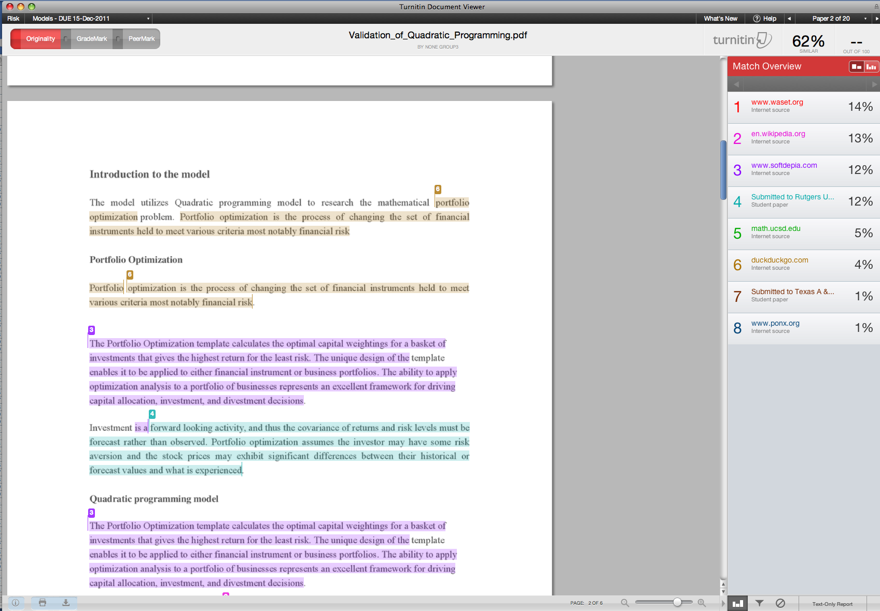

Extract from www.turnitin.com:

Slide 6
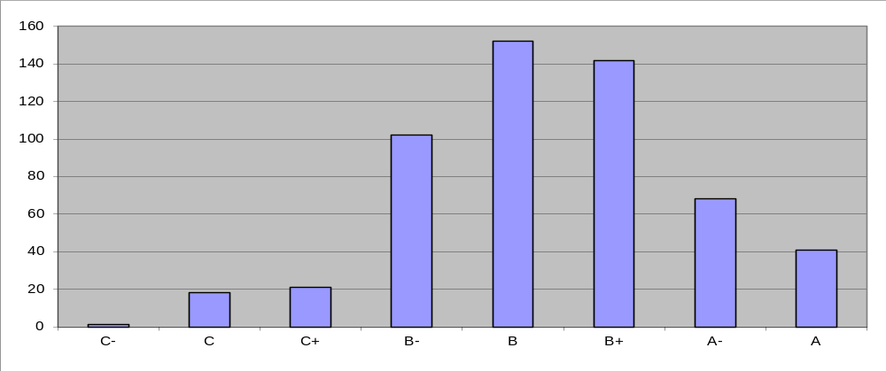
Overall Grades Distribution Since 2007
Grades Since 2007
--- about 20% ---
Mostly
Cheaters
Should have
been a D

Slide 7
Assumed Knowledge
Mid-level calculus
Elementary linear algebra
  Basic notation
  Eigenvalues/eigenvectors
  Factoring
  PSD matrices
Basic statistics
  Probability
    Density and distribution function s
    Conditional probability
  Inference
    Confidence intervals
    MLE
    Moments
  Regression
    (X’X)⁻¹X’Y
    Behavior of residuals
    Collinearity
  Correlation / Covariance matrices
Elementary time series
  Autocorrelation
  ARIMA
  GARCH
  lags
Basic spreadsheet techniques
  Graphs
  Relative references
  Range names
  Financial functions
Basic finance
  Bond pricing
  APT / CAPM
  Log functions
  Basic market structure
English

Slide 8
Etc
I am reachable
I prefer email to my work address
If you need to call, do so before 8AM or after 6PM
Lecture notes will be posted on the web
Grades will be as follows (subject to change):
  40% homework
  30% final
  30% midterm
  +/- 10% for class participation, at my discretion
Makeup exams will not be given
Homework is generally due after one week, but I’m flexible
I’d like HW sent to me via email TO BOTH ADDRESSES.
Do NOT send .zip or .rar files
I will generally get it back to you in a week

Slide 9
Homework
There will be several homework assignments
  Every assignment will involve something I’ve actually had to do
  Homework can (should) be done in groups of about four people
  I will be happy to answer questions about the homework via email
  Email me the HW question as well as your question
  Send the HW to my gmail AND work addresses
  PRESENTATION COUNTS
    Label your axes
    Use spell check
    Try to use decent grammar

Slide 10
Readings
I will assign recent topical material
Some have material I expect you to be responsible for, some is to provide background
Reading the WSJ is highly recommended
I APPRECIATE YOUR OPINIONS ON THE READINGS. LET ME KNOW.

Slide 11
How I Can Help You
Interview Background Reading
References
Job Descriptions
Minefield Awareness
Cover Letter Review
Resume Review
(Occasionally) Interviews

Slide 12
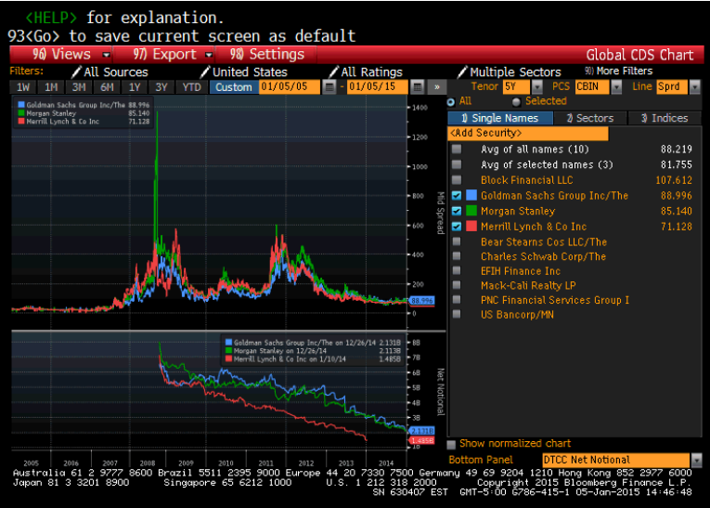
CDS Spreads

Slide 13
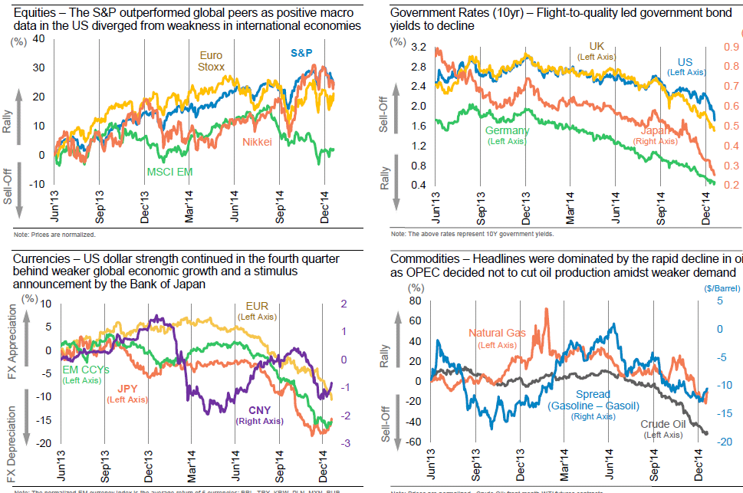
Markets

Slide 14
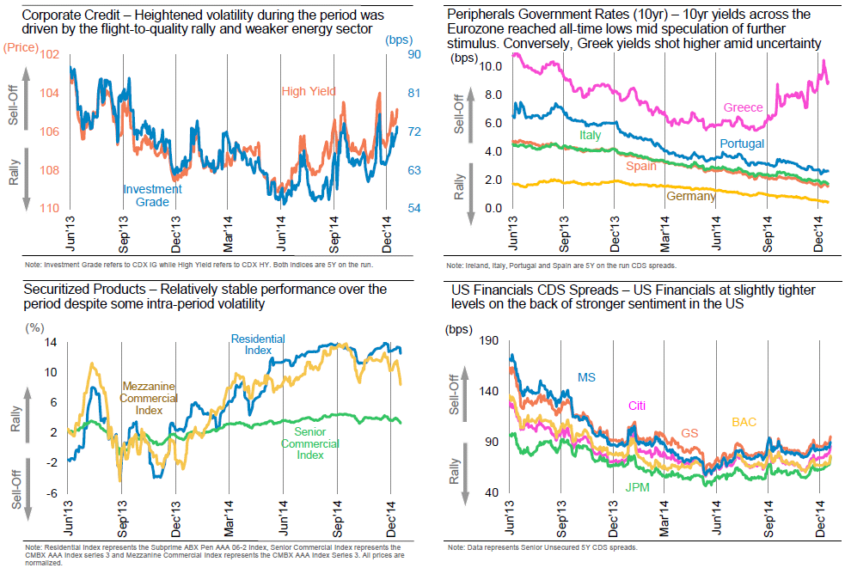
Markets

Slide 15
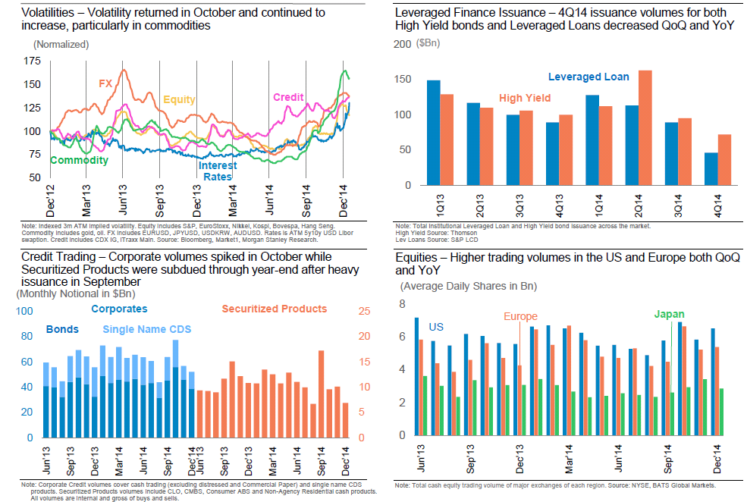
Markets

Slide 16
So, where are we now?
Post-crisis hangover
  What was that all about, anyway?
    Subprime
    Credit
  Regulatory overreaction?
  Regulatory overlap
  Massive shift of resources
  Relocation of trading
  Bureaucratic tangle

Slide 17
Risk Accountability
Whose fault was it, anyway?
  Were things booked correctly?
  Were the limits adequate?
  Who knew what?
  When did they know it?
  Was it clearly communicated?
  Was there franchise risk?
Was it just musical chairs?

Slide 18
Models Are a Key Issue
VaR models
  Systematic VaR
  Specific Risk
Pricing Models
Valuation Adjustments
Scenario/Stress Test Models

Slide 19
Capital is a Key Issue
Regulatory Capital
Economic Capital
ICAAP / CCAR

Slide 20
Dodd Frank is a Key Issue
Resolution Planning (I & II)
Enhanced Prudential Standards (I:165a-e)
Swap Dealer Stuff (VI)
Volcker (VII)
Consumer Protection (IX)

Slide 21
Basel is a Key Issue
Basel II implementation
Basel II.5 Implementation status
Basel III
Overall Basel Costs
Overall Basel Workload

